Slide 1
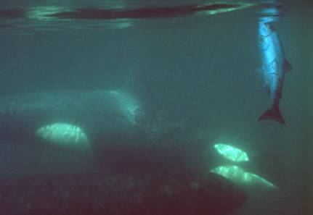
Sensitivity of resident killer whale population dynamics to Chinook salmon abundance
Antonio Vélez-Espino , John Ford, Graeme Ellis & Charles Parken
Pacific Biological Station
Fisheries and Oceans Canada
Nanaimo, BC
Notes:
1

Slide 2
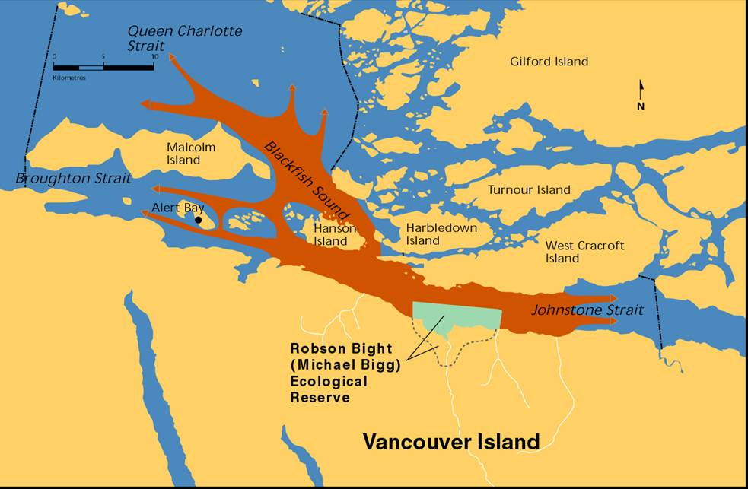
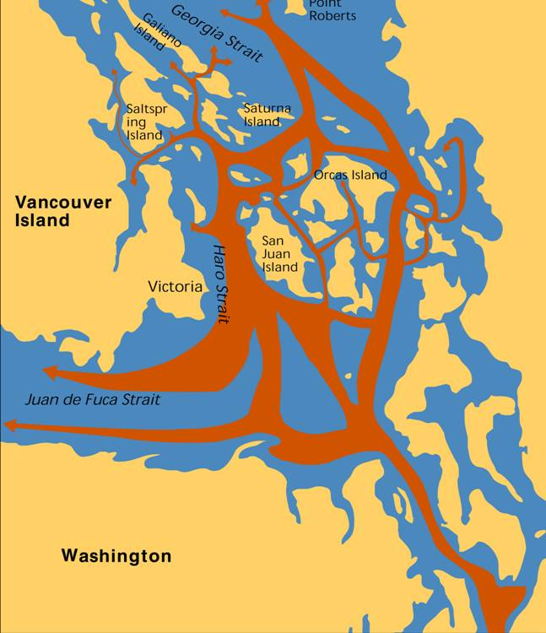
Range of resident populations
Northern resident
Southern resident
Notes:
2

Slide 3
Frequency distribution of salmonid species consumed by resident killer whale in different coastal regions (n = 806 kills).
130°W
N
SE Alaska
n = 74
55°N
55°N
British Columbia
n = 58
n = 429
n = 36
Key
50°N
Chinook
n = 45
50°N
Chum
Coho
n = 164
Washington
Pink
0
100
200
Kilometres
130°W

Slide 4
Salmonid species taken by month
100%
80%
Sockeye
60%
Pink
Percentage
Coho
40%
Chum
Chinook
20%
0%
May
Jun
Jul
Aug
Sep
Oct
Month
Notes:
4

Slide 5
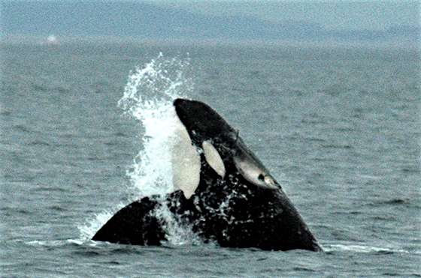
Why are Chinook preferred over other salmon?
(Chinook is the least abundant of the 5 species of Pacific salmon)
Largest of the salmonids
Highest fat content
Found in coastal waters year-round (ocean-type)
Center for Whale Research
Notes:
Chinook salmon is the least abundant of the five species of Pacific salmon

Slide 6
Chinook GSI for SRKW
Hanson et al. (2010)
Notes:
SRKW summer diet in critical habitat

Slide 7
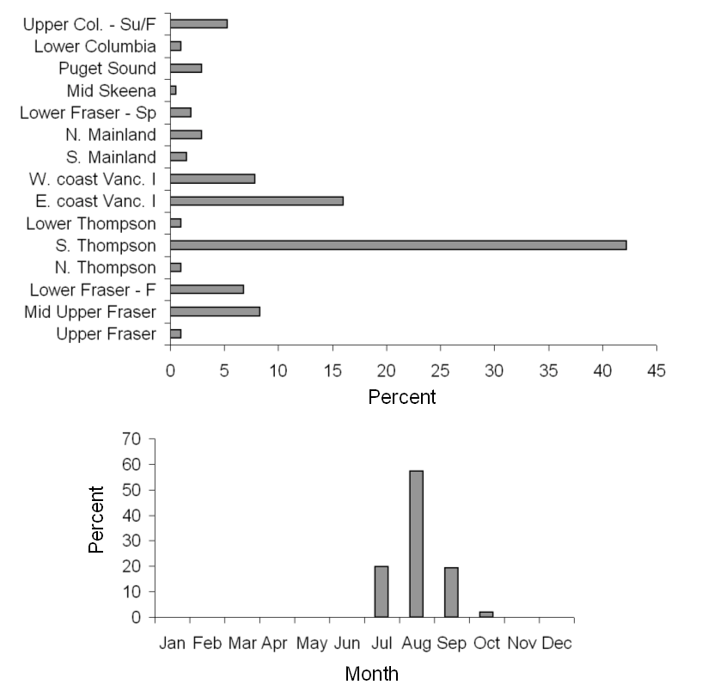
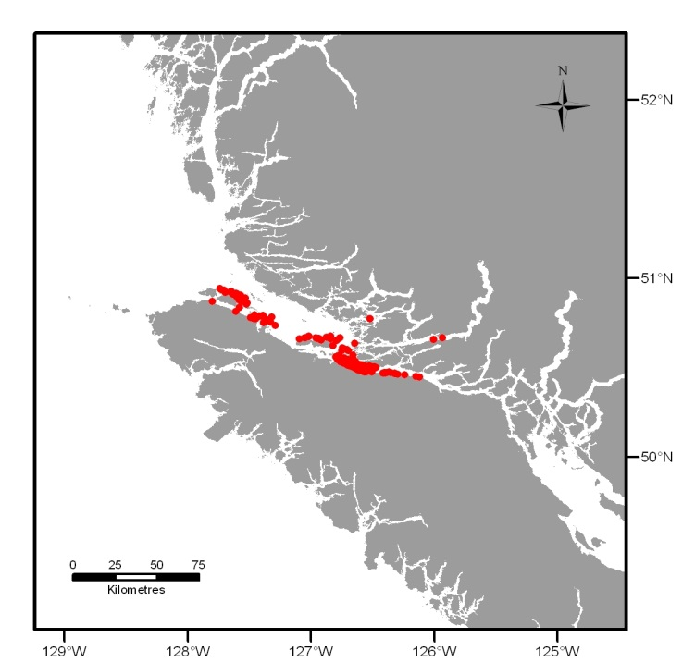
Locations of sampling, stock regions, and monthly distribution of Chinook salmon sampled from feeding events by northern resident killer whales in the northeastern Vancouver Island area (n = 205)
Ford et al. (2010)
Notes:
NRKW summer diet in critical habitat

Slide 8
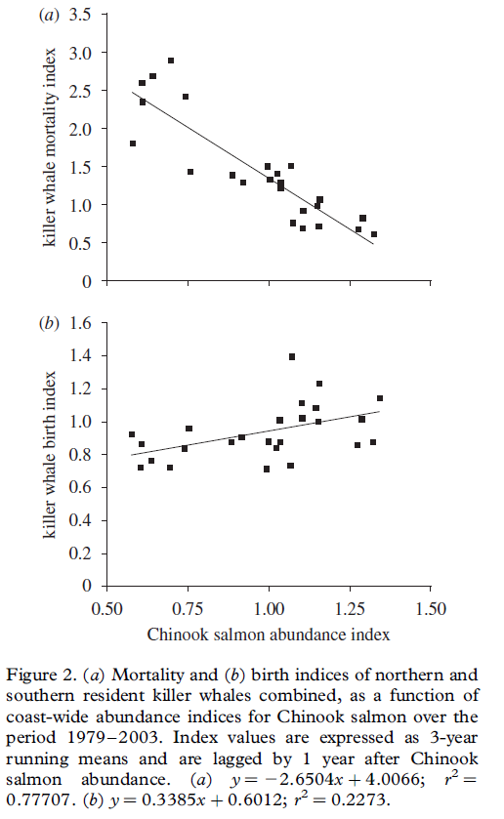
Correlations between RKW vital rates & Chinook abundance detected by previous studies (Ford et al. 2010)
Notes:
These studies posed the hypothesis that Chinook abundance and availability was limiting or influencing the population dynamics of RKW

Slide 9
Status
SRKW < 100 for the last generation (25 y) with an average of 85 in the last decade
NRKW generally increasing for the last generation with 268 individuals at the end of 2011
SRKW endangered in
Canada and U.S. while
NRKW threatened in
Canada
Notes:
Census data with individual identification available since 1973 but of greater quality in the late 80’s

Slide 10
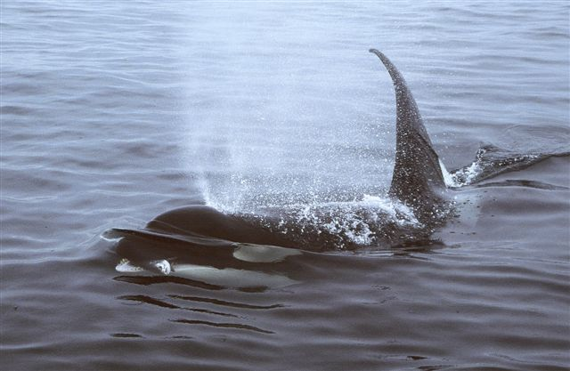
THE QUESTIONS
What are the demographic factors limiting population growth in SRKW and explaining the differences between both populations?
What is the influence of Chinook salmon on the population dynamics of both SRKW and NRKW?
How RKW populations are expected to respond to changes in Chinook fishing mortality?
M Malleson
Notes:
Chinook salmon from Oregon to southeast Alaska is managed under the PST and the possibility of adjusting fisheries to preserve killer whales became an international issue

Slide 11
SRKW and NRKW
Chinook Salmon (Terminal Run, Ocean abundance)
Life history data
Gender-specific: age-at-maturity, maximum reproductive age,
maximum age
Stage-specific: survival, fecundity, growth
Abundance data
stock; stock aggregates
Relationships between Chinook
abundance and vital rates
Vital rates (mean & variance)
Demographic projection matrices
Model Selection/Hypotheses
Perturbation analysis
Relative importance
of stage-specific vital
rates for recovery
potential
Retrospective
(LTRE)
Prospective
(i.e., elasticity)
Demographic factors
responsible for observed
KW abundance
variation
Sensitivity of SRKW
and NRKW population growth to
Chinook abundance
Notes:
Beta regressions were used to explore relationships between RKW vital rates and Chinook abundance

Slide 12
Identification of relevant
fishing scenarios
Perturbation
Analysis
Transient dynamics
PVA
Demographic
stochasticity
Environmental
stochasticity
KW Recovery Goals
Influence of Chinook abundance
on SRKW and NRKW
extinction and recovery
probabilities
Notes:
Next we will examine how these interactions influence rkw population viability within the framework of selected fishing scenarios

Slide 13
Main (strong) hypotheses regarding RKW-Chinook salmon interactions
Hypothesis 1a (based on current evidence):
  SRKW growth influenced by terminal run size of Fraser Early, Fraser Late, and Puget Sound Chinook
Hypothesis 1b (based on current evidence):
  NRKW growth influenced by
    terminal run size of Northern BC, Central BC, WCVI, and Georgia Strait Chinook salmon stocks
    ocean (pre-terminal) abundance of Fraser Early, Puget Sound, and Upper Columbia Chinook stocks
Notes:
Based on the diet-composition and GSI studies from summer samples
Define abundance types

Slide 14
Criteria for additional (weak) Hypotheses regarding RKW-Chinook salmon interactions: assuming Chinook remains an important diet component year-round
Stock size
(large contributions
to ocean fisheries)
Spatial overlap
(Ocean-type life history)
Temporal
overlap
(Possible access to the
resource outside of
summer ranges)
RKW-Chinook encounters
(North California to Southeast Alaska)
Influence on
RKW vital rates
Notes:
The main hypotheses look for greater support for causation whereas the additional hypotheses look for support for additional research
The probability of a RKW encountering (an preying on) a fish from a particular stock depends on stock size and spatial and temporal overlap

Slide 15
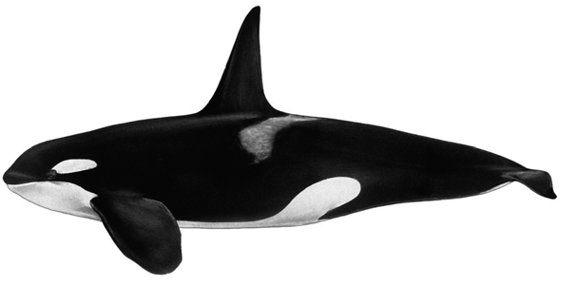
Killer Whale Demography

Slide 16

RKW two-sex birth-flow model
0 F2 F3 F4 0 0 0
G1 P2 0 0 0 0 0
0 G2f P3 0 0 0 0
0 0 G3 P4 0 0 0
0 0 0 G4 P5 0 0
0 G2m 0 0 0 P6 0
0 0 0 0 0 G6 P7
F4
F3
F2
1
2
3
4
5
G1
G2f
G3
G4
M =
P1
P2
P3
P4
P5
G2m
6
7
G6
P6
P7
1: Calves (viable 0.5-year old)
2: Juveniles (ages 2-9; undetermined sex)
3: Young reproductive females (ages 10-30)
4: Old reproductive females (ages 31-50)
5: Post-reproductive females (ages 51+)
6: Young mature males (ages 10-21)
7: Old mature males (ages 22+)
Female 1
Female 2
Female 3
Male 1
Male 2
Notes:
The greatest uncertainty comes from neonate survival rates
Two female stages to represent reproductive senescence
Two male stage to represent older males’ greater reproductive input
Lambda is the asymptotic growth rate
Having a discrete low number of stages facilitates the exploration of linkages with Chinook abundance
Matrix elements F=fertility; G=transition probability; P=survival

Slide 17
Model Type
Vital rates as random variables (iid, stochastic, and as function of Chinook abundance)
Two-sex, birth-flow model:
Notes:
Note: Phi is the proportion of juveniles transitioning into females or males
Note: F=fertility to differentiate from miu=fecundity

Slide 18
SRKW λ = 0.9909 (95% CI: 0.9719-1.0081)
NRKW λ = 1.0158 (95% CI: 1.0027-1.0285)

Slide 19
Vital rates
Vital rate value
* Lower viable-calf survival in SRKW than in NRKW
* Lower fecundity of older females in SRKW than in NRKW
* Greater vital rate variability in SRKW than in NRKW
Notes:
Notice that survival is high for all stages

Slide 20
Cumulative difference in vital-rate value (1987-2011)

Slide 21
Sensitivity of population growth to changes in vital rates (prospective)
Calf Juvenile Female 1 Female 2 Female 3 Male 1 Male 2 Female Female 1 Female 2 Survival Survival Survival Survival Survival Survival Survival Prop. Fecundity Fecundity
Notes:
In a two-sex model, the proportion of females can become another vital rate
Post-reproductive females and males do not contribute to population growth
Any change (e.g., derived from salmon interactions) in Female-1 survival is expected to have the greatest effect on population growth

Slide 22
Maximum increase in population growth from maximization of individual vital rates (1.0 for survival; upper 95% CL for fecundity)
Necessary increase to attain U.S. SRKW target population growth rate (2.3% per year)
λ = 1.017
Calf Juvenile Female 1 Female 2 Female 1 Female 2
Survival Survival Survival Survival Fecundity Fecundity
Notes:
Downlisting U.S. recovery target seems unrealistic

Slide 23
NRKW vital rate reduction required to produce equilibrium (λ=1.000)
Calf Juvenile Female 1 Female 2 Female 1 Female 2
Survival Survival Survival Survival Fecundity Fecundity
Maximum reduction
Notes:
To show the greatest influence of Female-1 survival on population growth and the lowest influence of Female-2 fecundity

Slide 24
Life Table Response Experiments at the vital-rate level (retrospective)
Calf Juvenile Female 1 Female 2 Female 1 Female 2
Survival Survival Survival Survival Fecundity Fecundity
SRKW: Survival of young reproductive females had largest contribution
NRKW: Fecundity of young reproductive females had largest contribution
Notes:
Female-1 survival has the largest elasticity and the largest contribution to the variance in lambda in SRKW
Female-1 Fecundity had the largest contribution to the variance in lambda in NRKW
Although we extracted additional information from the retrospective analysis, I will focus on the application of prospective evaluations to management

Slide 25
Greatest benefits to λ
Avoiding reductions to survival of young reproductive females (Female-1)
Increasing fecundity rates (particularly of Female-1)

Slide 26
Sensitivity of Killer Whale population growth to Chinook abundance

Slide 27
Elasticities of “interactions” for SRKW
Notes:
“Interactions” is used to refer to the relative importance that changes in Chinook abundance are expected to have on population growth through its relationship with a given vital rate
Survival elasticities are smaller because the slope for survival regressions is much smaller than for fecundity

Slide 28
Elasticities of interactions for NRKW
Notes:
Only one interaction with calf survival

Slide 29
Notes:
This is a subset of interactions including: the strongest individual, additive, and cumulative
Elasticities are very small
Stock definition: Stock_AbundanceType_Lag

Slide 30
Notes:
The identification of these stocks is relevant for managers and scientist involved in Pacific salmon management…
Elasticities are also very small

Slide 31
PVA: selected fishing scenarios (2/12)
(elasticities: low sensitivity of killer whale λ to changes in Chinook abundance)
Recovery Objective for SRKW
  Maximize Chinook abundance (i.e., minimize fishing mortality)
  Maximize vital rates
  Whatever occurs first
Response Objective for NRKW
  Halting population growth (λ = 1.000)
  Maximize fishing mortality
  Whatever occurs first
Notes:
To explore these scenarios we had very good data on Chinook catch, stock composition and maturation rates

Slide 32
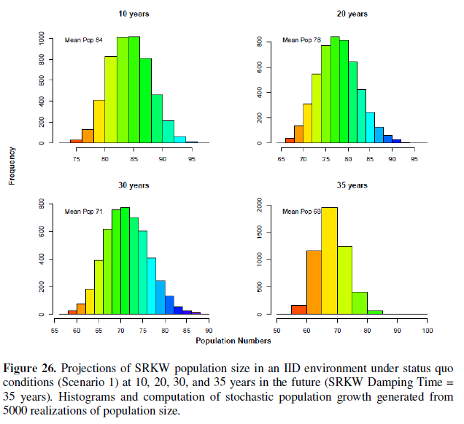
SRKW under status quo conditions – Population size

Slide 33
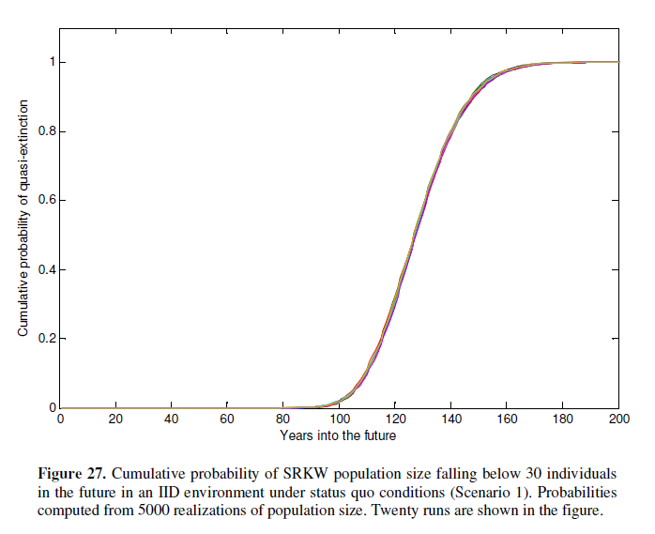
SRKW under status quo conditions – Quasi-extinction (iid)

Slide 34
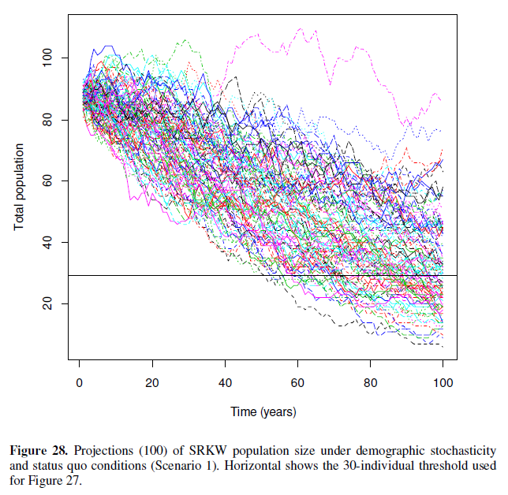
SRKW under status quo conditions – Demographic Stochasticity

Slide 35
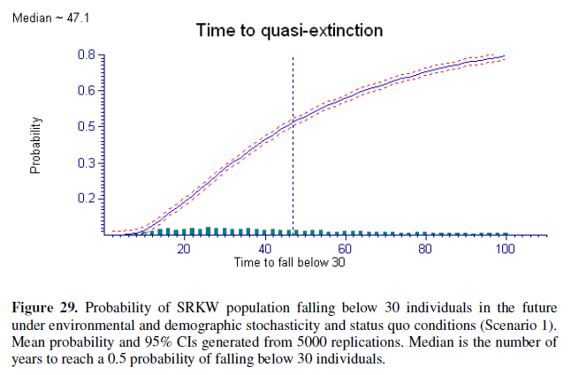
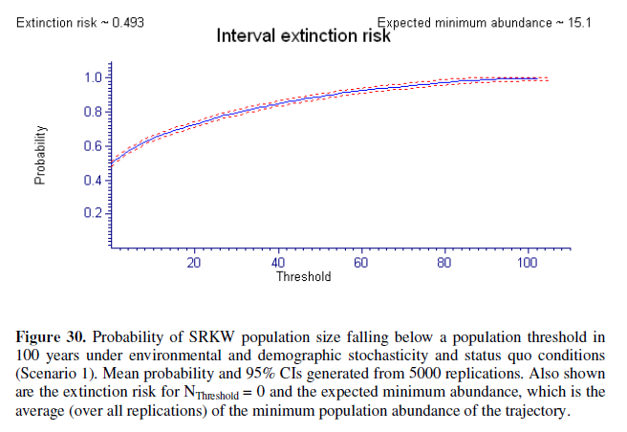

SRKW under status quo conditions – Extinction risk
RAMAS

Slide 36
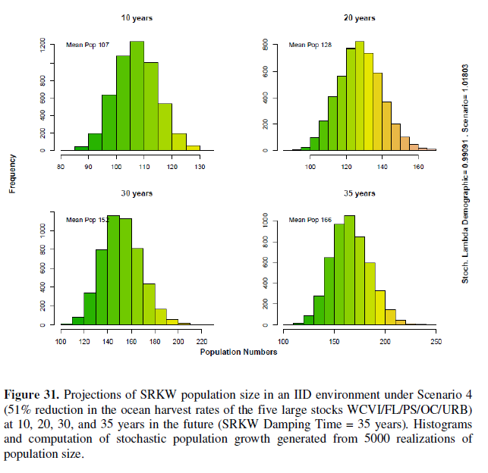
SRKW under Scenario 4 (strongest response) – Population size
Weak hypothesis

Slide 37
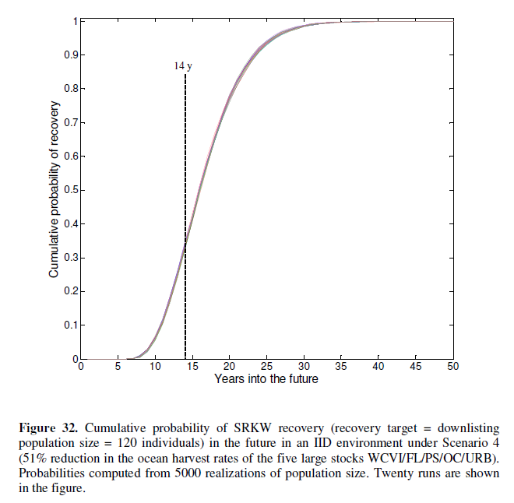
SRKW under Scenario 4 – Quasi-extinction (iid)

Slide 38
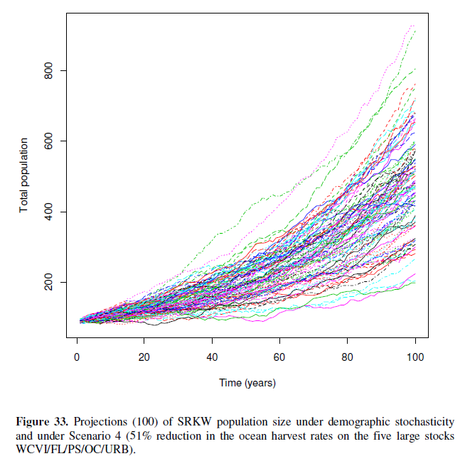
SRKW under Scenario 4 – Demographic Stochasticity

Slide 39
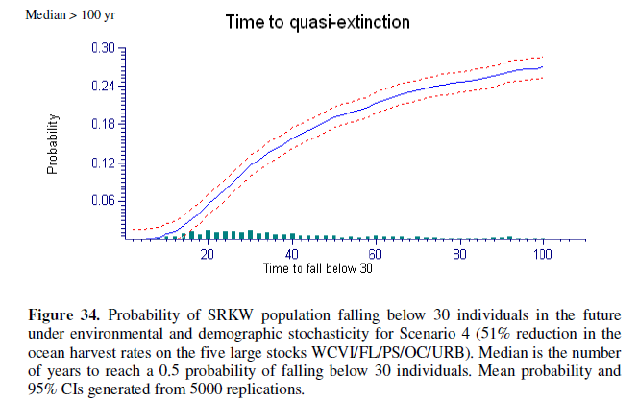
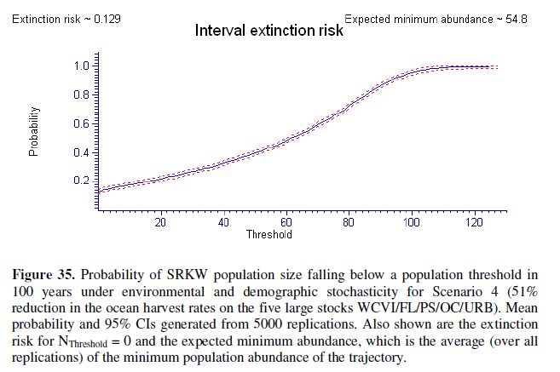
SRKW under Scenario 4 – Extinction risk

Slide 40
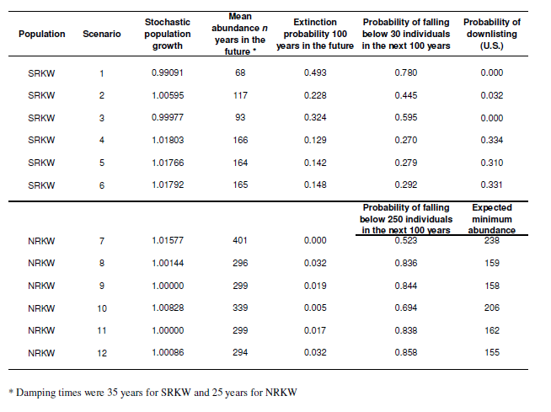

PVA Summary for Selected Fishing Scenarios
Status quo
Fishing closures
Strong hypothesis
(causation)
Weak hypothesis
(assumptions)
Status quo
Strong hypothesis
(causation)
Weak hypothesis
(assumptions)

Slide 41
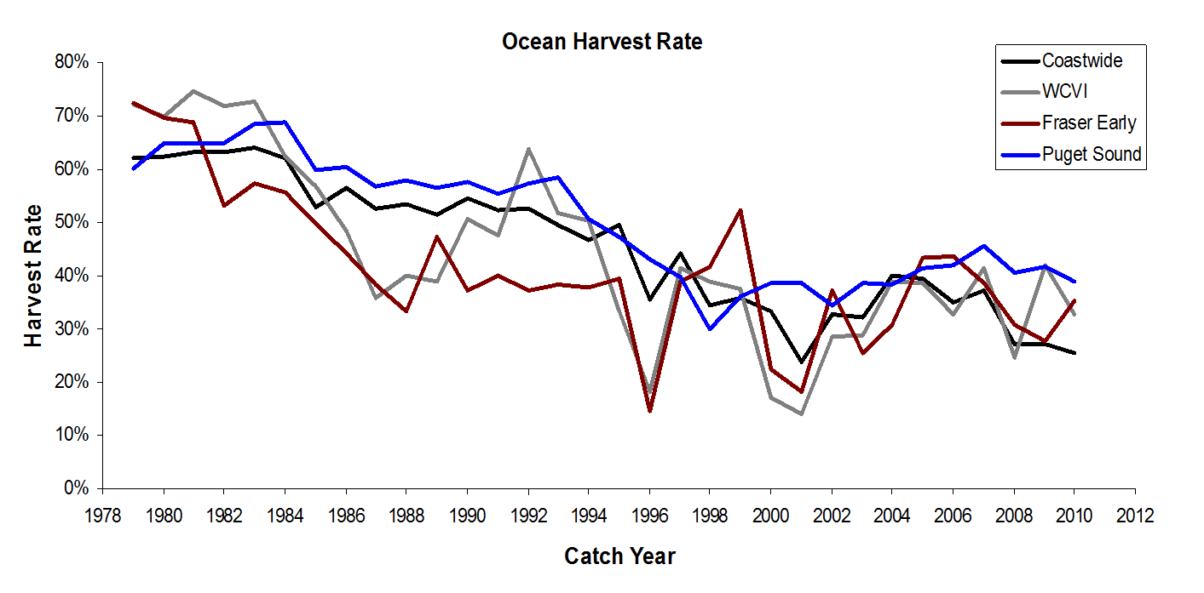
CONCLUSIONS
Q1: What are the demographic factors limiting population growth in SRKW and explaining the differences between both populations?
Lower production and survival of calves
Greater vital-rate variance
Stronger influence of demographic stochasticity
No evidence differences are due to differential access to Chinook resources, declines in Chinook abundance, or increasing fishing mortality
Notes:
Other factors could include genetic stochasticity, inbreeding avoidance as a deterrent for reproductive opportunities
Other threats: pollutants and boat traffic

Slide 42
CONCLUSIONS
Q2: What is the influence of Chinook salmon on the population dynamics of both SRKW and NRKW?
Numerous interactions between killer whale vital rates & Chinook abundance
Interactions were weak on statistical & demographic grounds
Other factors maybe limiting SRKW population growth & probably masking detection of stronger interactions
Some interactions lent support for causation (Fraser River & Puget Sound)
130°W
N
55°N
SE Alaska
55°N
British Columbia
50°N
50°N
Washington
0
100
200
Kilometres
130°W

Slide 43
CONCLUSIONS
Q3: How RKW populations are expected to respond to changes in Chinook fishing mortality?
Maximum expected change in population growth resulting from a δ% change in the Chinook abundance of a given stock aggregate never exceeded 0.048*δ in SRKW or 0.046*δ in NRKW
These low interaction levels could still produce slightly positive population growth rates in SRKW approximately 50% of the time under extreme reductions to fishing mortality
It remains a challenge exerting adjustments to ocean harvest rates of specific Chinook stock aggregates in mixed-stock fisheries

Slide 44
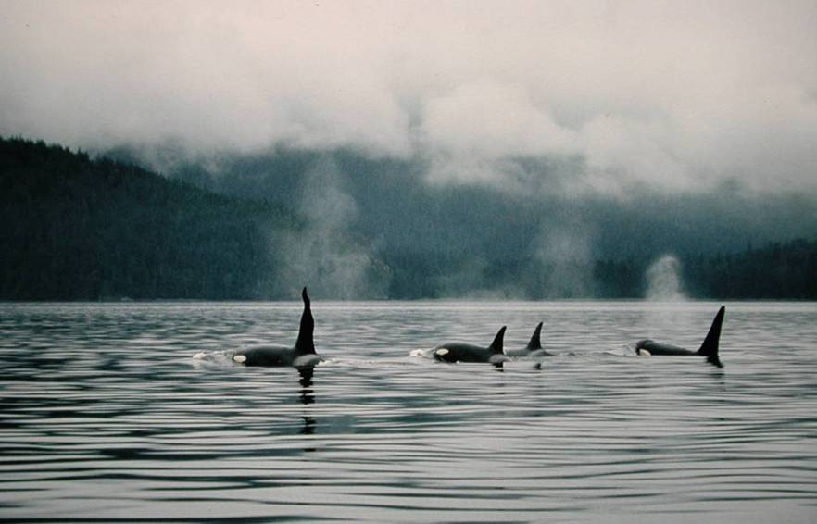
THANKS!!
QUESTIONS?
Prepared for:
BioVeL Workshop “Modeling population response to environmental change” Amsterdam, March 5-8 2013
Notes:
44
Individual identification

